Slide 1
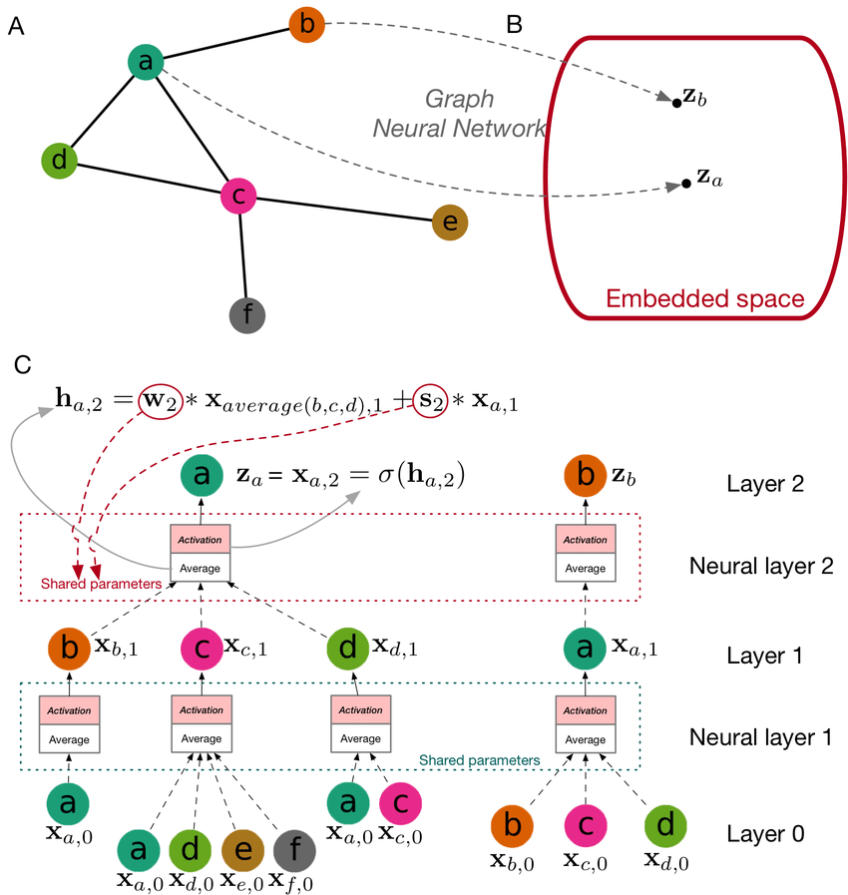


Graph Neural Networks
张江
北京师范大学系统科学学院教授
集智俱乐部、集智学园创始人
集智研究中心理事长
北师大系统科学学院：面向复杂系统的人工智能，2024
Notes:
封面

Slide 2
Outline
Background
Network Embedding
Graph Neural Networks
Graph Convolution
Graph Attention Network
Other extension
Variational Graph Autoencoder
Graph Generation
北师大系统科学学院：面向复杂系统的人工智能，2024

Slide 3
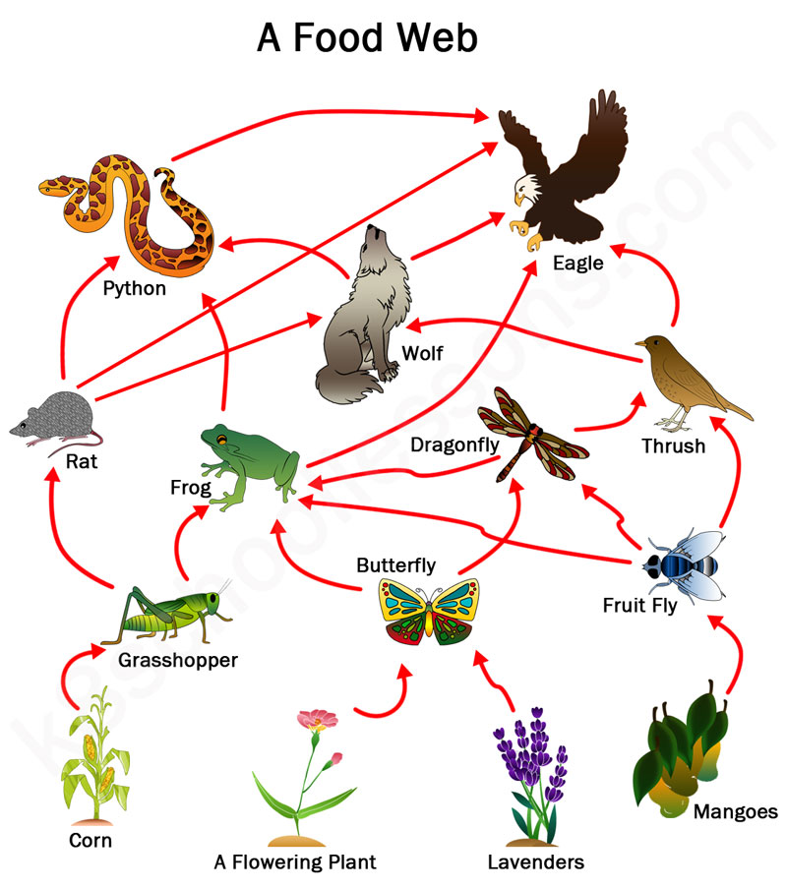
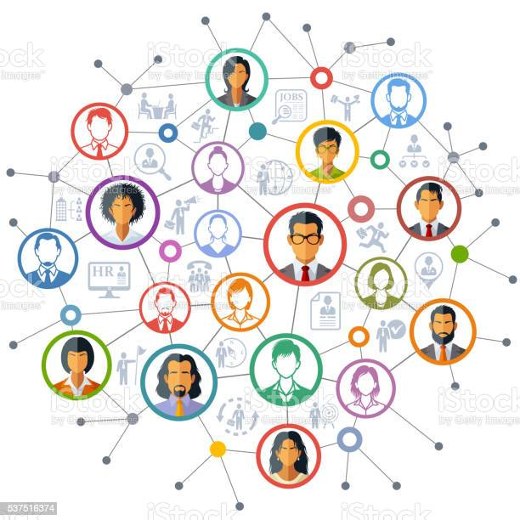
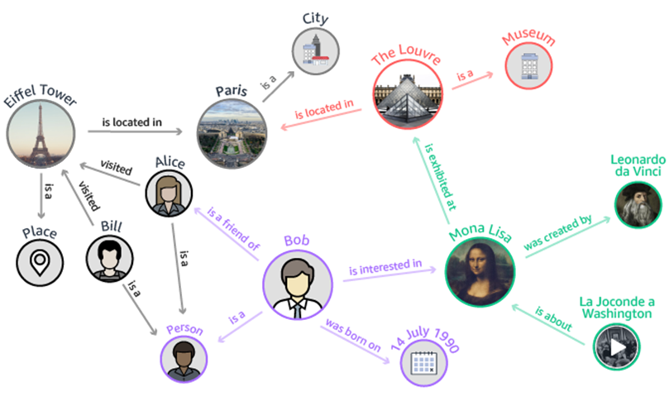
Networks Are Everywhere
北师大系统科学学院：面向复杂系统的人工智能，2024

Slide 4
Images v.s. Graphs
Image = 2D Grid
Social Network
Regulatory Network
Functional Network
Michael Bronstein et al., Geometric Deep Learning, CVPR Tutorial 21 July 2017, Honolulu
北师大系统科学学院：面向复杂系统的人工智能，2024

Slide 5
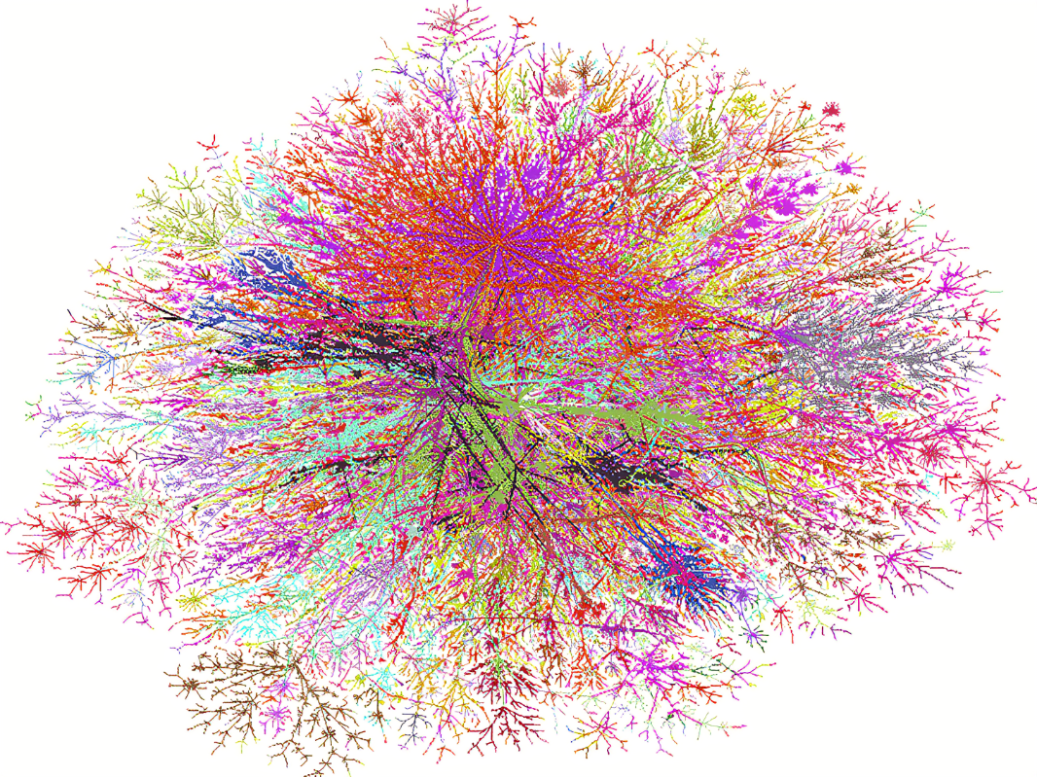
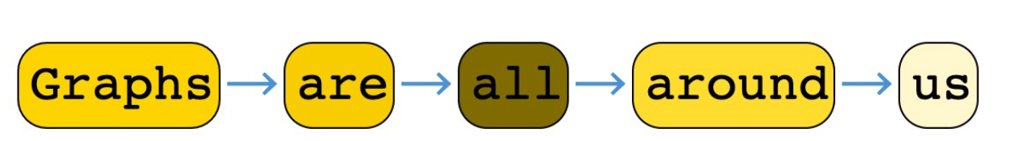
Sequences v.s. Graphs
北师大系统科学学院：面向复杂系统的人工智能，2024

Slide 6
Outline
Background
Network Embedding
Graph Neural Networks
Graph Convolution
Graph Attention Network
Other extension
Variational Graph Autoencoder
Graph Generation
北师大系统科学学院：面向复杂系统的人工智能，2024

Slide 7
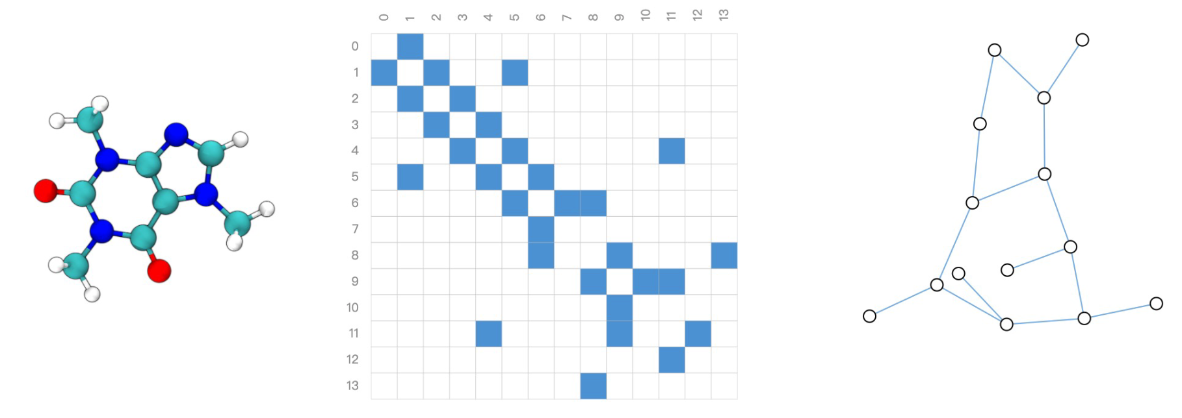
How to represent a graph?
分子结构式
图
邻接矩阵
北师大系统科学学院：面向复杂系统的人工智能，2024

Slide 8
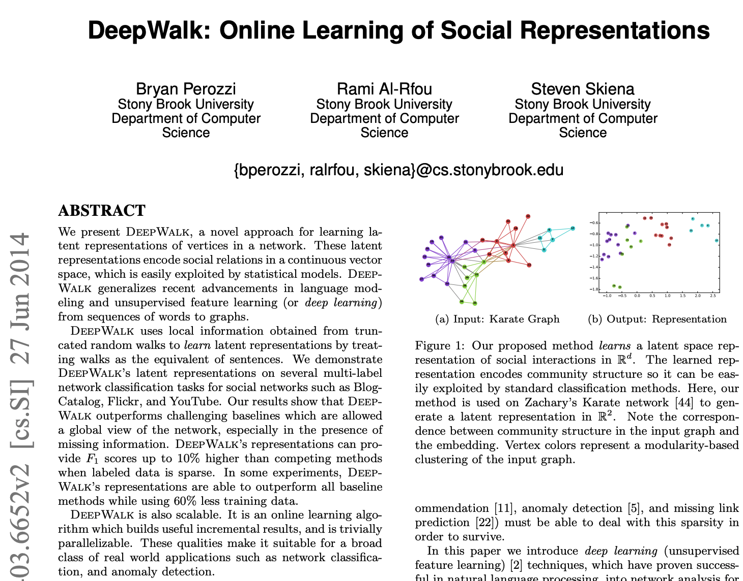
How to represent a graph?
Node Sequences
Random Walk
……
https://arxiv.org/pdf/1403.6652.pdf

Slide 9
Neural Language Model
聊天
Yoshua Bengio
我
聊天
机器人
，
我
可以
聊天
是
F.Sun et al.: Learning Word Representations by Jointly Modeling Syntagmatic and Paradigmatic Relations (slides), http://www.bigdatalab.ac.cn/~lanyanyan/slides/2015/ACL2015-sun.pdf

Slide 10
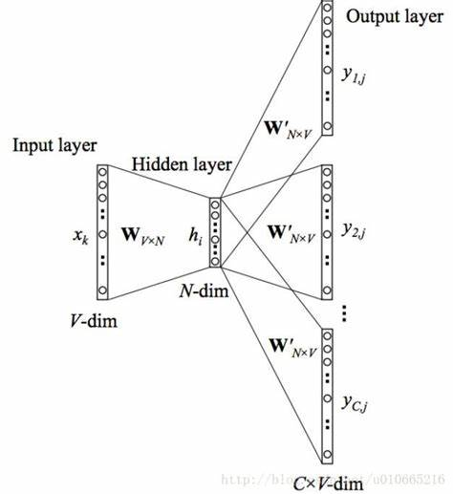
Deep Walk
Node Sequences
Word2Vec
Node Vectors
Random Walk
N₁
……
N₂
N₃
N₄
N₅
N₆
N₇
N₈
N₉
N₁₀
https://arxiv.org/pdf/1403.6652.pdf

Slide 11
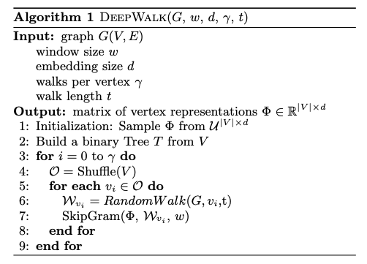
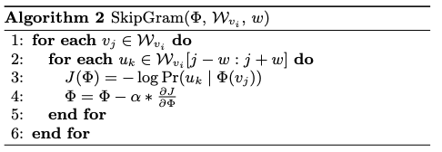
Deep Walk
https://arxiv.org/pdf/1403.6652.pdf

Slide 12
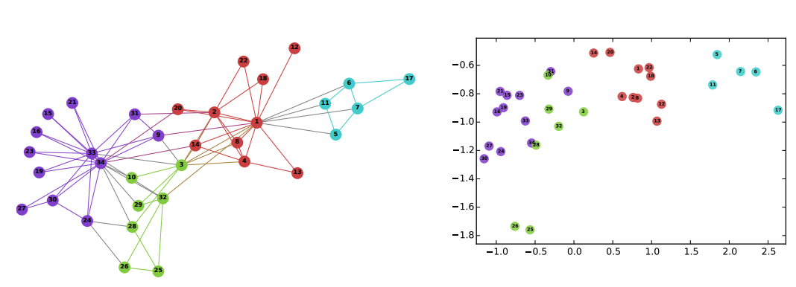
Deep Walk
https://arxiv.org/pdf/1403.6652.pdf

Slide 13
Tasks
Node level：Node classification, Node properties prediction, Community detection, Visualization
Link level：Link classification, Link Prediction, Link property inference
Graph level：Graph classification, Graph generation
……
北师大系统科学学院：面向复杂系统的人工智能，2024

Slide 14
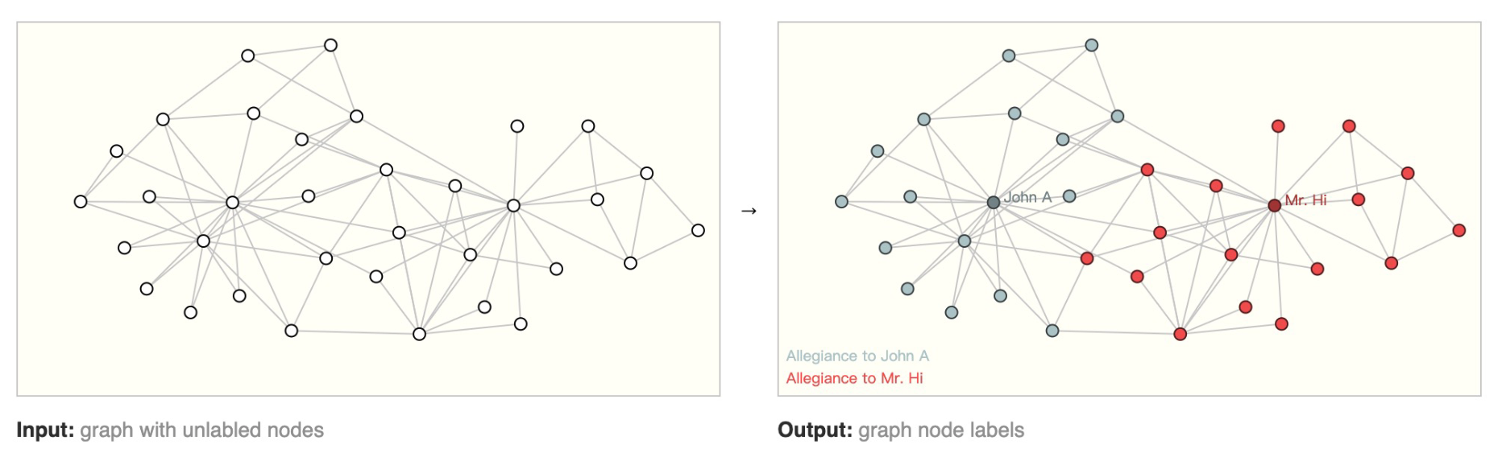
Node Classification/Labelling
有监督、无监督、半监督
北师大系统科学学院：面向复杂系统的人工智能，2024

Slide 15
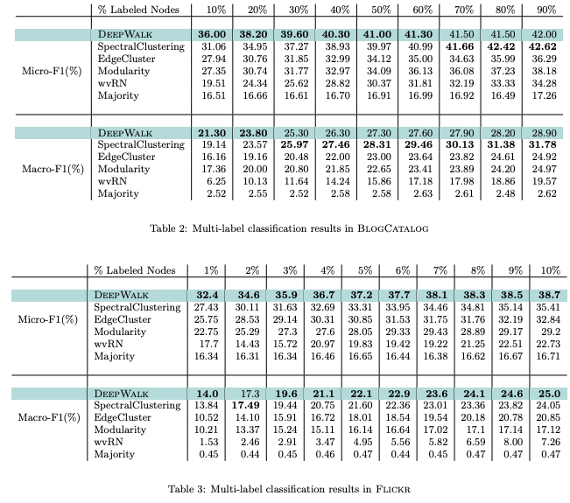
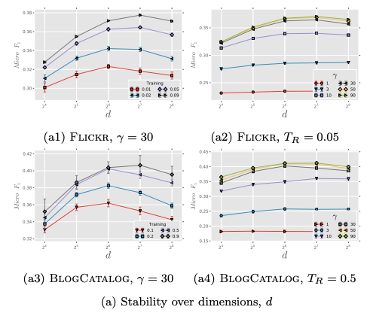
Deep Walk
https://arxiv.org/pdf/1403.6652.pdf

Slide 16
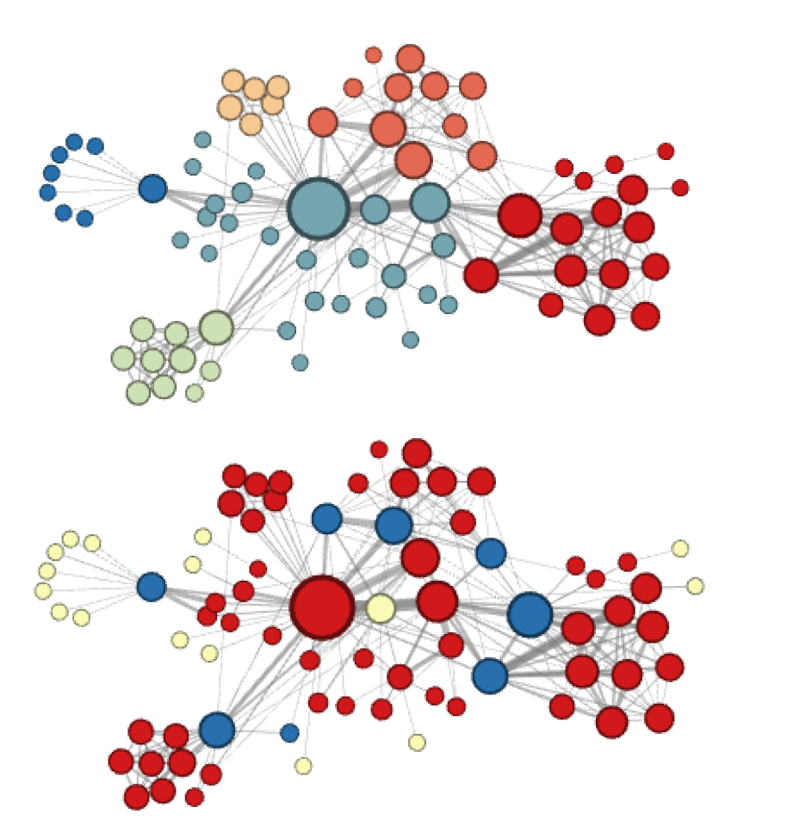
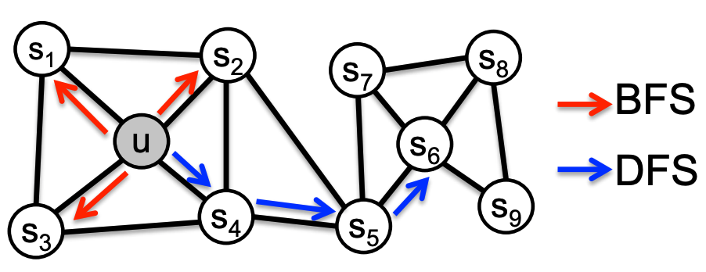
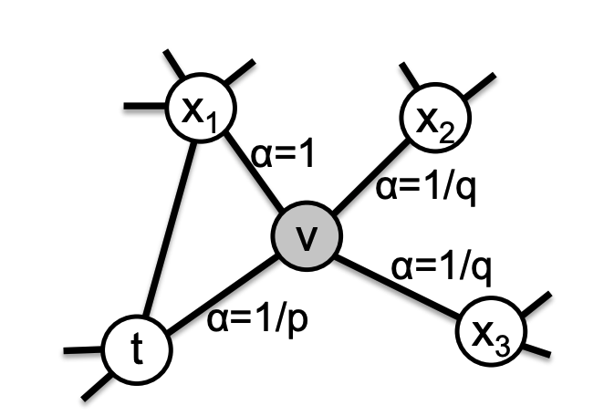
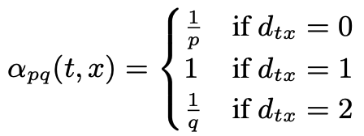
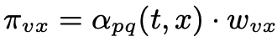

Node2Vec
Homophily, p=1,q=0.5
Structural equivalence, p=1, q=2
Aditya Grover, Jure Leskovec. node2vec: Scalable Feature Learning for Networks. KDD 2016.

Slide 17
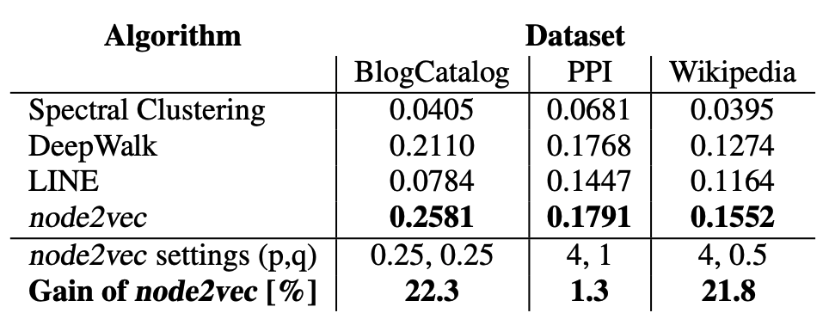
Node Classification/Labelling
39 blogger interests
50 gene types
40 Part-of-Speech tags
Aditya Grover, Jure Leskovec. node2vec: Scalable Feature Learning for Networks. KDD 2016.

Slide 18
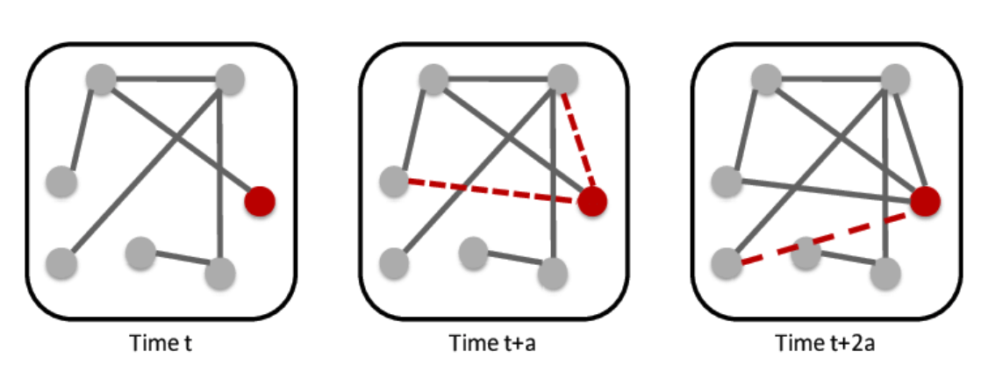
Link Prediction
北师大系统科学学院：面向复杂系统的人工智能，2024

Slide 19
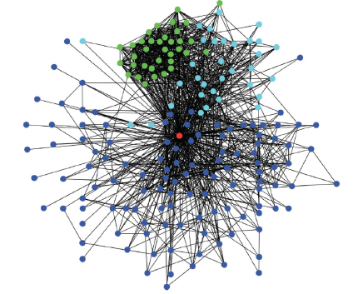
Link Prediction
北师大系统科学学院：面向复杂系统的人工智能，2024

Slide 20
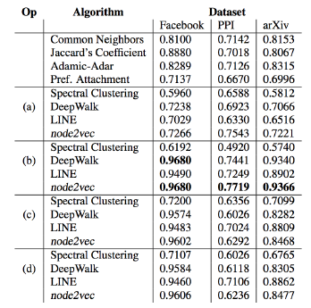
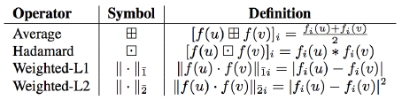
Link Prediction
u,v: nodes, f: embedding function
Area Under Curve (AUC) scores for link prediction. Comparison with popular baselines and embedding based methods bootstapped using binary operators:
(a) Average, (b) Hadamard, (c) Weighted-L1, and (d) Weighted-L2 (See Table 1 for definitions).
北师大系统科学学院：面向复杂系统的人工智能，2024

Slide 21
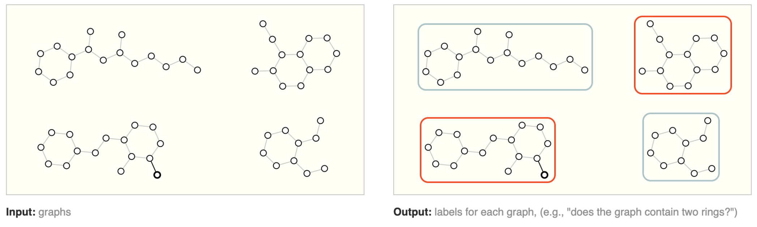
Graph Level Tasks
北师大系统科学学院：面向复杂系统的人工智能，2024

Slide 22
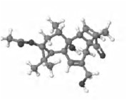
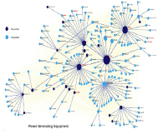
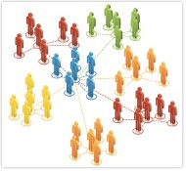
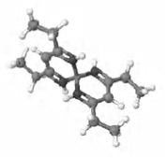
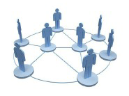
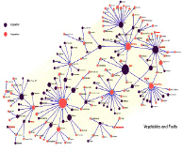
Graph Classification
分子结构网络
社会网络
国际贸易网
Toxic
Long lived
Industrial
non-toxic
Dead
Agricultrual
化学药品分类
网络社区分类
贸易产品分类
北师大系统科学学院：面向复杂系统的人工智能，2024

Slide 23
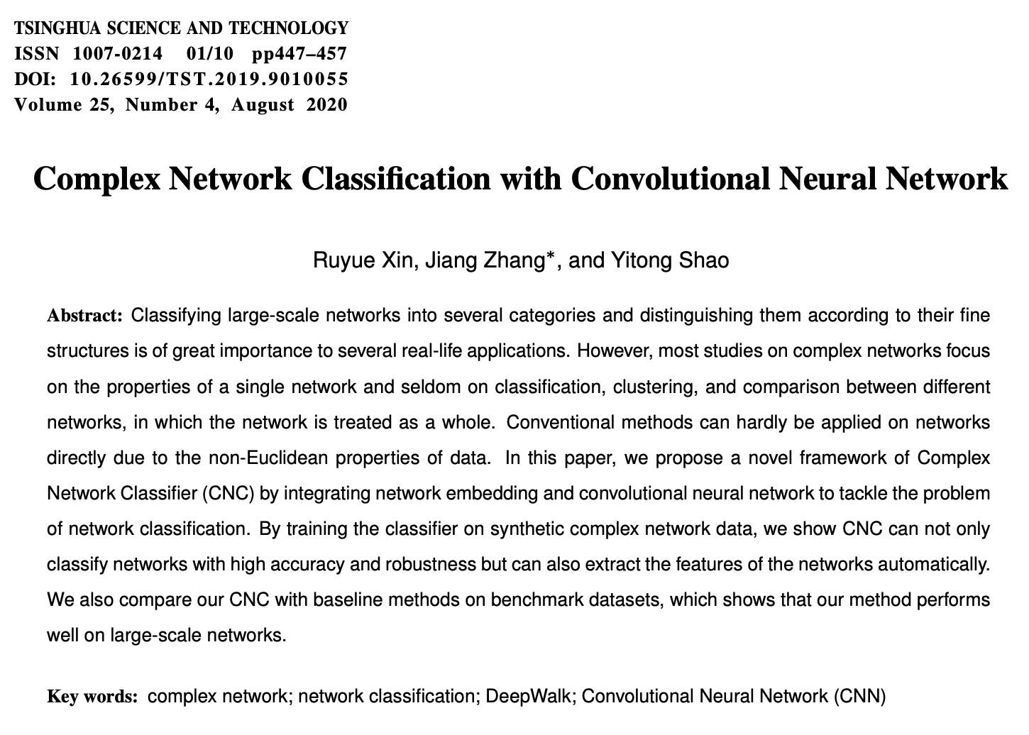
Graph Classification
Ruyue Xin,Jiang Zhang,Yitong Shao. Complex Network Classification with Convolutional Neural Network; Tsinghua Science and Technology, Volume 25, Number 4, 2020

Slide 24
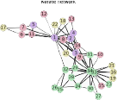
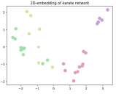
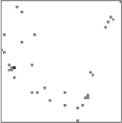
Graph Classification
原始网络
嵌入向量
二维栅格化
Class 1
Class 2
CNN：卷积神经网络
Ruyue Xin,Jiang Zhang,Yitong Shao. Complex Network Classification with Convolutional Neural Network; Tsinghua Science and Technology, Volume 25, Number 4, 2020

Slide 25
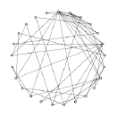
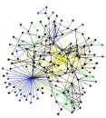
Graph Classification
嵌入向量
二维栅格化
小世界网络
无标度网络
CNN：卷积神经网络
Ruyue Xin,Jiang Zhang,Yitong Shao. Complex Network Classification with Convolutional Neural Network; Tsinghua Science and Technology, Volume 25, Number 4, 2020

Slide 26
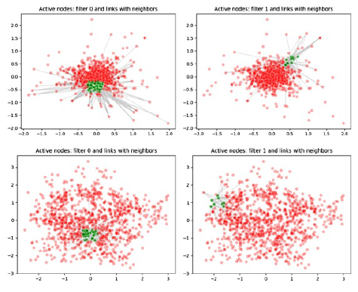
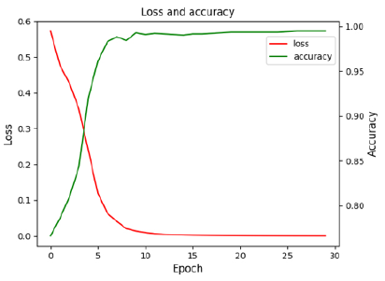
Results
无标度
小世界
Ruyue Xin,Jiang Zhang,Yitong Shao. Complex Network Classification with Convolutional Neural Network; Tsinghua Science and Technology, Volume 25, Number 4, 2020

Slide 27
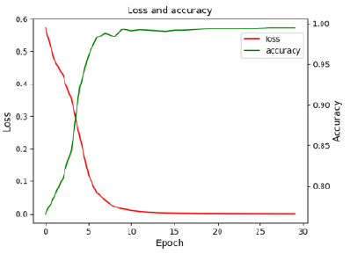

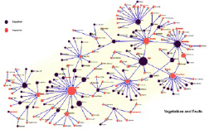
Results
Electronic
Agricultrual
The classifier can distinguish agricultural trade networks and electronic product trade networks with accuracy 99%
Ruyue Xin,Jiang Zhang,Yitong Shao. Complex Network Classification with Convolutional Neural Network; Tsinghua Science and Technology, Volume 25, Number 4, 2020

Slide 28
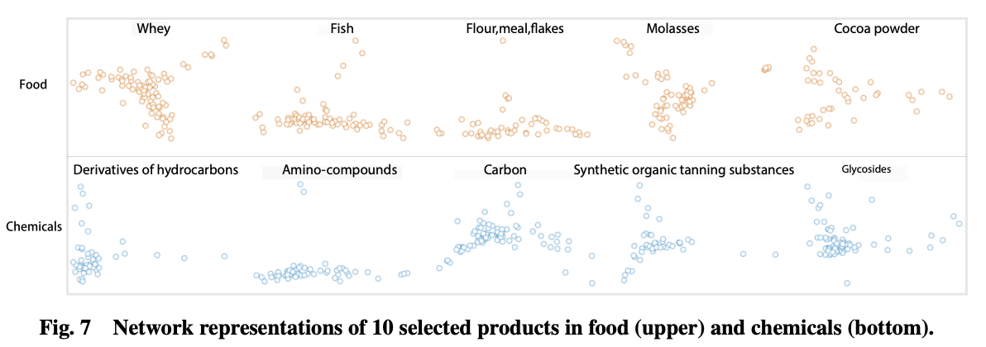
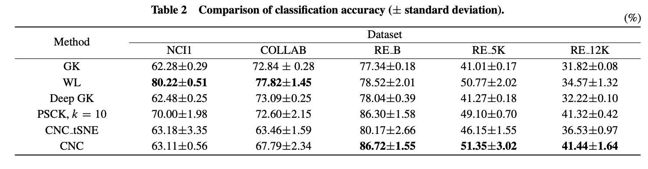
Results
Ruyue Xin,Jiang Zhang,Yitong Shao. Complex Network Classification with Convolutional Neural Network; Tsinghua Science and Technology, Volume 25, Number 4, 2020

Slide 29
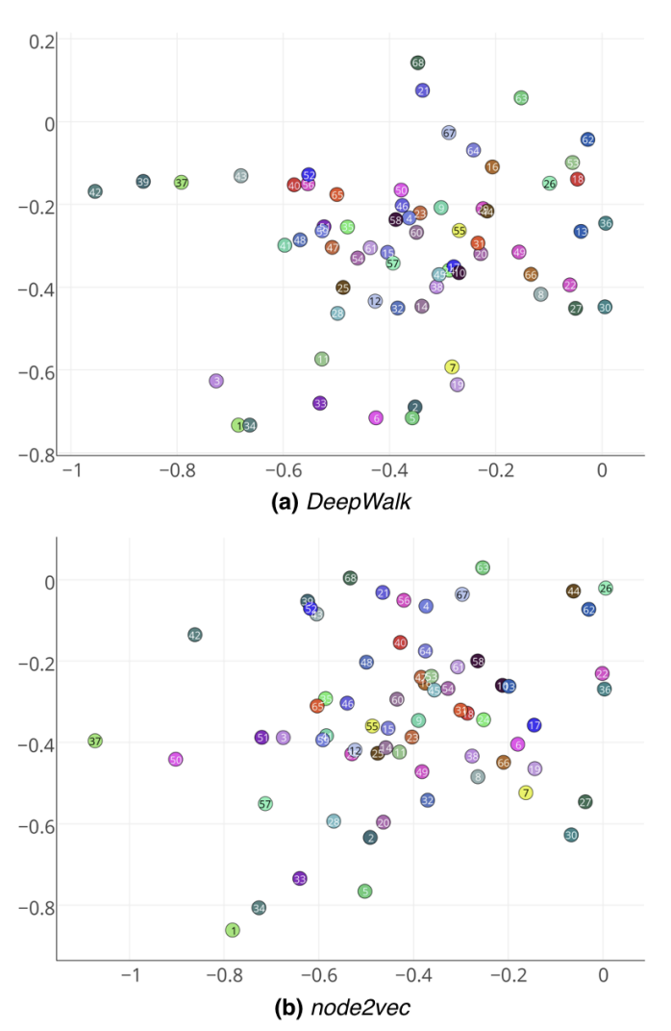
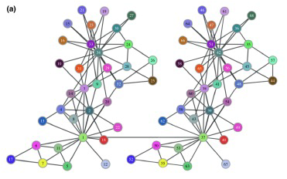
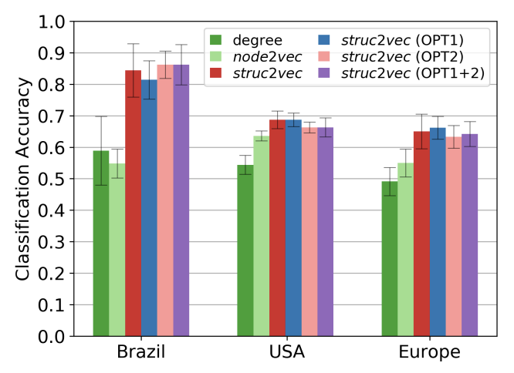
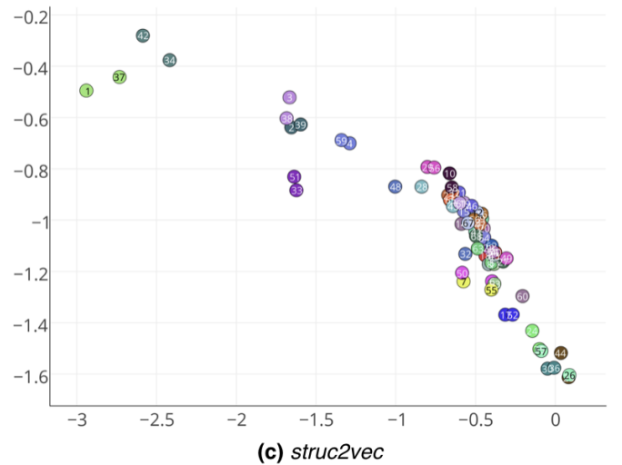
Struct2vec
Leonardo F. R. Ribeiro, Pedro H. P. Saverese, Daniel R. Figueiredo. struc2vec: Learning Node Representations from Structural Identity. KDD 2017

Slide 30
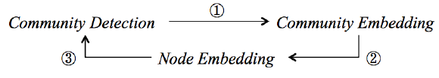
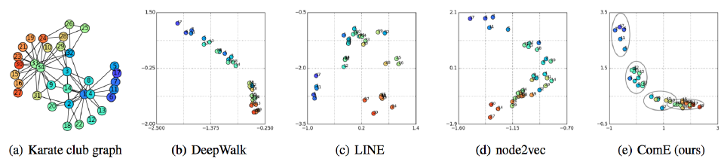
Node – Community Embedding
V.W. Zheng et al.: From Node Embedding To Community Embedding, arXiv:1610.09950v2 , 2017

Slide 31


Knowledge Graph
TransE, TransR
Knoweledge Graph
Embedding
更多“人工智能 & 复杂系统”的知识，请关注官网：campus.swarma.org

Slide 32

Knowledge Graph Embedding
$$d\left(sub,rel,obj\right)=|\left|h+r−t\right||2$$
Wang Z. Knowledge Graph Embedding by Translating on Hyperplanes[J]. AAAI - Association for the Advancement of Artificial Intelligence, 2014.

Slide 33
Multi layer
更多“人工智能 & 复杂系统”的知识，请关注官网：campus.swarma.org

Slide 34
Weak points
Time consuming by random walks
Embedding vectors depend on graph, change with graph
Hard to incorporate information of node and edge attributes
Depends on word2vec
北师大系统科学学院：面向复杂系统的人工智能，2024

Slide 35
Outline
Background
Network Embedding
Graph Neural Networks
Graph Convolution
Graph Attention Network
Other extension
Variational Graph Autoencoder
Graph Generation
北师大系统科学学院：面向复杂系统的人工智能，2024

Slide 36

Neural Networks
北师大系统科学学院：面向复杂系统的人工智能，2024

Slide 37

Network Embedding v.s. Graph Neural Networks
北师大系统科学学院：面向复杂系统的人工智能，2024

Slide 38


What is Graph Neural Network？
北师大系统科学学院：面向复杂系统的人工智能，2024

Slide 39

Principles of GNN
Node Classification
Input:
Topology (network)
Node attribution
Output:
Classification (Label)
世界是紧密联系的
方案1：将每个节点的特征认为相互独立，训练一个MLP
方案2：每个节点的分类和自己与邻居的特征都有关
节点对称性：每个节点的信息聚合、分类准则都是一样的！
北师大系统科学学院：面向复杂系统的人工智能，2024

Slide 40


Node Symmetry
f
f
北师大系统科学学院：面向复杂系统的人工智能，2024

Slide 41

Information Aggregation
Aggregation:
Use neighbors’ information to update my feature
Recursive:
Aggregation can be recursive
The orders of aggregation is the layer
Self
First order neighbor
Second order neighbor
北师大系统科学学院：面向复杂系统的人工智能，2024

Slide 42

Message Passing
Define Two Functions
Aggregate
Aggregate information of neighborhood to form message m
Update
Update self information according to m and my own feature
北师大系统科学学院：面向复杂系统的人工智能，2024

Slide 43

Message Passing
Requirement for aggregate：
Permutation invariant
$$\left\{1,2,3\right\}≅\{1,3,2\}≅\{2,1,3\}≅\{2,3,1\}≅\{3,1,2\}≅\{3,2,1\}$$
Variant Length
$$\left\{1,2,3\right\},\left\{1, 2\right\},\{6\}$$
Examples:
$$Mean\left(\left\{1,2,3\right\}\right)=2, Sum\left(\left\{1,2,3\right\}\right)=6, Product\left(\left\{1,2,3\right\}\right)=6$$
北师大系统科学学院：面向复杂系统的人工智能，2024

Slide 44

Deep Set
https://arxiv.org/pdf/1703.06114.pdf

Slide 45
Deep Set
Aggregation Function must be set function(permutation invariant):
https://arxiv.org/pdf/1703.06114.pdf

Slide 46

Deep Set
Aggregation Function must be set function(permutation invariant):
https://arxiv.org/pdf/1703.06114.pdf

Slide 47

Graph Convolutional Network(GCN)
https://tkipf.github.io/graph-convolutional-networks/

Slide 48




Graph Convolutional Network(GCN)
$$m_{𝒩(u)}^{k}=Aggragate\left(\left\{h_{u}^{k}|v∈𝒩(u)\right\}\right)=\frac{\sum_{v∈𝒩(u)}{h_{u}^{k}}}{|𝒩(u)|}$$
$$m_{𝒩(u)}^{k}=Aggragate\left(\left\{h_{u}^{k}|v∈𝒩(u)\right\}\right)=\sum_{v∈𝒩(u)}{\frac{h_{u}^{k}}{\sqrt{|𝒩(u)|∙|𝒩(v)|}}}$$
$$h_{u}^{k+1}=Update\left({h_{u}^{k},m}_{𝒩(u)}^{k}\right)=σ(W_{u}^{k}\frac{h_{u}^{k}}{\left|𝒩\left(u\right)\right|}+W_{m}^{k}m_{𝒩(u)}^{k})$$
https://tkipf.github.io/graph-convolutional-networks/

Slide 49





Graph Convolutional Network(GCN)
$$m_{𝒩(u)}^{k}=Aggragate\left(\left\{h_{u}^{k}|v∈𝒩(u)\right\}\right)=\sum_{v∈𝒩(u)}{\frac{h_{u}^{k}}{\sqrt{|𝒩(u)|∙|𝒩(v)|}}}$$
$$h_{u}^{k+1}=Update\left({h_{u}^{k},m}_{𝒩(u)}^{k}\right)=σ(W_{u}^{k}\frac{h_{u}^{k}}{\left|𝒩\left(u\right)\right|}+W_{m}^{k}m_{𝒩(u)}^{k})$$
$$H^{k+1}=σ({\hat{D}}^{−\frac{1}{2}}\hat{A}{\hat{D}}^{−\frac{1}{2}}H^{k}W^{k})$$
$$\hat{A}=A+I$$
$$\hat{D}=diag(Degree\left(\hat{A}\right))$$
https://tkipf.github.io/graph-convolutional-networks/

Slide 50



No Training – just graph convolution
$$Z=Hash\left(\sum_{v∈N\left(u\right)}{h_{v}}\right)$$
https://tkipf.github.io/graph-convolutional-networks/

Slide 51
Semi Supervised
北师大系统科学学院：面向复杂系统的人工智能，2024

Slide 52

Results
北师大系统科学学院：面向复杂系统的人工智能，2024

Slide 53
History of GCN
Image Convolution
Graph Signal Processing
Graph Convolution
Spatial GCN
Spectral Graph Convolution
北师大系统科学学院：面向复杂系统的人工智能，2024

Slide 54
Back to Kipf’s GCN
参考和进一步阅读
1.入门博客：A Gentle Introduction to Graph Neural Networks
2.入门课本：Graph Representation Learning
3.入门公开课：CS224W:Machine Learning with Graphs
4.最新博客：Michael Bronstein
北师大系统科学学院：面向复杂系统的人工智能，2024

Slide 55




Graph Attention Network
https://arxiv.org/abs/1710.10903

Slide 56


Graph Attention Network
https://arxiv.org/abs/1710.10903

Slide 57


Comparison
GCN
Deep Set
$$m_{𝒩(u)}^{k}=Aggragate\left(\left\{h_{u}^{k}|v∈𝒩(u)\right\}\right)=\frac{\sum_{v∈𝒩(u}{h_{u}^{k}}}{|𝒩(u)|}$$
$$m_{𝒩(u)}^{k}=Aggragate\left(\left\{h_{u}^{k}|v∈𝒩(u)\right\}\right)=\sum_{v∈𝒩(u)}{\frac{h_{u}^{k}}{\sqrt{|𝒩(u)|∙|𝒩(v)|}}}$$
Graph Attention：
https://arxiv.org/pdf/1703.06114.pdf

Slide 58
Extension: Update
北师大系统科学学院：面向复杂系统的人工智能，2024

Slide 59

Extended Message Passing
北师大系统科学学院：面向复杂系统的人工智能，2024

Slide 60

Extended Message Passing
北师大系统科学学院：面向复杂系统的人工智能，2024

Slide 61

Dynamics Learning on Graph
更多“人工智能 & 复杂系统”的知识，请关注官网：campus.swarma.org

Slide 62


PM2.5 Forecasting
王硕
李嫣然
Shuo Wang, Yanran Li, Jiang Zhang, Qingye Meng, Lingwei Meng, and Fei Gao. 2020. PM2.5-GNN: A Domain Knowledge Enhanced Graph Neural Network For PM2.5 Forecasting. In Proceedings of the 28th International Conference on Advances in Geographic Information Systems (SIGSPATIAL '20). Association for Computing Machinery, New York, NY, USA, 163–166. https://doi.org/10.1145/3397536.3422208

Slide 63


Tasks
Shuo Wang, Yanran Li, Jiang Zhang, Qingye Meng, Lingwei Meng, and Fei Gao. 2020. PM2.5-GNN: A Domain Knowledge Enhanced Graph Neural Network For PM2.5 Forecasting. In Proceedings of the 28th International Conference on Advances in Geographic Information Systems (SIGSPATIAL '20). Association for Computing Machinery, New York, NY, USA, 163–166. https://doi.org/10.1145/3397536.3422208

Slide 64


Input Attributes
Shuo Wang, Yanran Li, Jiang Zhang, Qingye Meng, Lingwei Meng, and Fei Gao. 2020. PM2.5-GNN: A Domain Knowledge Enhanced Graph Neural Network For PM2.5 Forecasting. In Proceedings of the 28th International Conference on Advances in Geographic Information Systems (SIGSPATIAL '20). Association for Computing Machinery, New York, NY, USA, 163–166. https://doi.org/10.1145/3397536.3422208

Slide 65






Network Constructing
$$ρ_{i}$$
$$d_{ij}$$
$$ρ_{j}$$
h
$$H\left(x\right)=\left\{\begin{matrix}1. if x>0 \\ 0. if x≤0\end{matrix}\right.$$
Shuo Wang, Yanran Li, Jiang Zhang, Qingye Meng, Lingwei Meng, and Fei Gao. 2020. PM2.5-GNN: A Domain Knowledge Enhanced Graph Neural Network For PM2.5 Forecasting. In Proceedings of the 28th International Conference on Advances in Geographic Information Systems (SIGSPATIAL '20). Association for Computing Machinery, New York, NY, USA, 163–166. https://doi.org/10.1145/3397536.3422208

Slide 66





Model
Shuo Wang, Yanran Li, Jiang Zhang, Qingye Meng, Lingwei Meng, and Fei Gao. 2020. PM2.5-GNN: A Domain Knowledge Enhanced Graph Neural Network For PM2.5 Forecasting. In Proceedings of the 28th International Conference on Advances in Geographic Information Systems (SIGSPATIAL '20). Association for Computing Machinery, New York, NY, USA, 163–166. https://doi.org/10.1145/3397536.3422208

Slide 67

Results – Time Series
Shuo Wang, Yanran Li, Jiang Zhang, Qingye Meng, Lingwei Meng, and Fei Gao. 2020. PM2.5-GNN: A Domain Knowledge Enhanced Graph Neural Network For PM2.5 Forecasting. In Proceedings of the 28th International Conference on Advances in Geographic Information Systems (SIGSPATIAL '20). Association for Computing Machinery, New York, NY, USA, 163–166. https://doi.org/10.1145/3397536.3422208

Slide 68




Results
Shuo Wang, Yanran Li, Jiang Zhang, Qingye Meng, Lingwei Meng, and Fei Gao. 2020. PM2.5-GNN: A Domain Knowledge Enhanced Graph Neural Network For PM2.5 Forecasting. In Proceedings of the 28th International Conference on Advances in Geographic Information Systems (SIGSPATIAL '20). Association for Computing Machinery, New York, NY, USA, 163–166. https://doi.org/10.1145/3397536.3422208

Slide 69

Ablation – Domain Knowledge
Shuo Wang, Yanran Li, Jiang Zhang, Qingye Meng, Lingwei Meng, and Fei Gao. 2020. PM2.5-GNN: A Domain Knowledge Enhanced Graph Neural Network For PM2.5 Forecasting. In Proceedings of the 28th International Conference on Advances in Geographic Information Systems (SIGSPATIAL '20). Association for Computing Machinery, New York, NY, USA, 163–166. https://doi.org/10.1145/3397536.3422208

Slide 70
Outline
Background
Network Embedding
Graph Neural Networks
Graph Convolution
Graph Attention Network
Other extension
Variational Graph Autoencoder
Graph Generation
北师大系统科学学院：面向复杂系统的人工智能，2024

Slide 71
Network Embedding v.s. Graph Neural Networks
Graph Convolution Networks
Matrix Factorization
Graph Attention Networks
Graph
Auto-encoder
Random Walk
Graph Generative Networks
Network Embedding
Graph Spatial-temporal Networks
Graph Neural Networks
北师大系统科学学院：面向复杂系统的人工智能，2024

Slide 72


Autoencoder
Unsupervised learning
Feed-back
Reconstruct input:
BP Learning
Constraints
北师大系统科学学院：面向复杂系统的人工智能，2024

Slide 73

Variational Autoencoder
北师大系统科学学院：面向复杂系统的人工智能，2024

Slide 74

Graph Autoencoder
https://arxiv.org/pdf/1611.07308.pdf

Slide 75

Variational Graph Autoencoder
https://github.com/tkipf/gae

Slide 76


Variational Graph Autoencoder
Encoder：
Decoder:
(generative model)：
Learning:
https://github.com/tkipf/gae
https://zhuanlan.zhihu.com/p/78340397

Slide 77
Link Prediction
北师大系统科学学院：面向复杂系统的人工智能，2024

Slide 78


Results – Variational Graph Autoencoder
https://arxiv.org/pdf/1611.07308.pdf

Slide 79


Representation via Link Prediction
谷伟伟
https://ieeexplore.ieee.org/document/9355034
https://www.nature.com/articles/s41598-021-85826-x

Slide 80

Main Idea
Graph Attention Network for Link Prediction
Centrality
Community
Node Classification
https://arxiv.org/abs/1710.10903

Slide 81
Pipe Line
Graph Attention Network
Network
Attention
Node Vector
Node Vector
Backward
Gu, W., Gao, F., Lou, X. et al. Discovering latent node Information by graph attention network. Scientific Reports 11, 6967 (2021).

Slide 82
Graph Attention Network
https://arxiv.org/abs/1710.10903

Slide 83


Pipe Line
Connection Probability Matrix
Network
Graph Attention Network
Node Vectors
N₁
Node Vectors
N₂
N₃
N₄
$$σ$$
N₅
N₆
N₇
N₈
N₉
N₁₀
Node Vectors
Backward
Gu, W., Gao, F., Lou, X. et al. Discovering latent node Information by graph attention network. Scientific Reports 11, 6967 (2021).

Slide 84





Graph Attention Network for Large Networks
$$e_{ij}=h_{i}^{′}∙h_{j}^{′}$$
Gu, W., Gao, F., Lou, X. et al. Discovering latent node Information by graph attention network. Scientific Reports 11, 6967 (2021).

Slide 85
Results – Link Prediction
Gu, W., Gao, F., Lou, X. et al. Discovering latent node Information by graph attention network. Scientific Reports 11, 6967 (2021).

Slide 86
Pipe Line
j
Node Vectors
Network
Graph Attention Network
i
Attentional weights matrix
N₁
N₂
N₃
N₄
Logistic
N₅
N₆
N₇
N₈
N₉
N₁
N₁₀
N₂
N₃
N₄
N₅
N₆
N₇
Node Vectors
N₈
N₉
N₁₀
Gu, W., Gao, F., Lou, X. et al. Discovering latent node Information by graph attention network. Scientific Reports 11, 6967 (2021).

Slide 87


Results – Visualization
VC network: VC co-invest
Visualization for attentional matrix by MDS algorithm
Gu, W., Gao, F., Lou, X. et al. Discovering latent node Information by graph attention network. Scientific Reports 11, 6967 (2021).

Slide 88
Results – Centrality
Label
Label
Gu, W., Gao, F., Lou, X. et al. Discovering latent node Information by graph attention network. Scientific Reports 11, 6967 (2021).

Slide 89

Results – Centrality
Figure 1. The comparison between the spreading power of different ranking algorithms over F(t). In panels (a) and (b), we plot the average number of F(t) for t = 3 of the top-L users as ranked by the five centrality measures of Cora (a) and Citeseer (b) graphs, while in panels (b) and (d), we plot the average number of F(t) for t = 9 of Cora (c) and Citeseer (d) graphs.
Gu, W., Gao, F., Lou, X. et al. Discovering latent node Information by graph attention network. Scientific Reports 11, 6967 (2021).

Slide 90

Results – Centrality
Gu, W., Gao, F., Lou, X. et al. Discovering latent node Information by graph attention network. Scientific Reports 11, 6967 (2021).

Slide 91

Node Clustering
Cora dataset
GraphSAGE
Ours
ours
Visualization for Node Representation Vectors
Gu, W., Gao, F., Lou, X. et al. Discovering latent node Information by graph attention network. Scientific Reports 11, 6967 (2021).

Slide 92
Node Clustering
ours
Deep Linker = ours
Gu, W., Gao, F., Lou, X. et al. Discovering latent node Information by graph attention network. Scientific Reports 11, 6967 (2021).

Slide 93
Network Completion
Missing data
Noisy data
Incomplete information
Social network
Gene network
Brain network
Citation network
北师大系统科学学院：面向复杂系统的人工智能，2024

Slide 94
Two Kinds of Tasks
Random Missing
Block Missing
北师大系统科学学院：面向复杂系统的人工智能，2024

Slide 95

Matrix Completion v.s. Network Completion
https://ieeexplore.ieee.org/document/9334012

Slide 96



Kronecker Graphs
https://arxiv.org/pdf/0812.4905.pdf

Slide 97


Kronecker Graphs
P. M. Weichsel, "The kronecker product of graphs", J. Am. Math. Soc, vol. 13, no. 1, pp. 47-52, 1962.

Slide 98

Kronecker Graphs
M. Kim and J. Leskovec, "The network completion problem: Inferring missing nodes and edges in networks", Proc. 2011 SIAM Int. Conf. Data Mining (SDM '11), pp. 47-58, Apr. 2011.

Slide 99

C-GIN Network Completion
张章
陶如意
https://arxiv.org/pdf/2204.11852.pdf

Slide 100





Encoder:
C-GIN Network Completion
Decoder:
Loss function:
$$ℒ\left(θ\right)=−\sum_{i=0}^{N_{O}−2}{\sum_{j=i+1}^{N_{O}}{\left[A_{ij}\log{P_{ij}}+\left(1−A_{ij}\right)\log{(1−P_{ij})}\right]}}$$
Scale factor:
$$γ=\frac{N^{2}−N_{O}^{2}}{N_{O}^{2}}∙\frac{\sum_{i,j<N_{O}}{A_{ij}}}{\sum_{i,j<N}{P_{ij}}−\sum_{i,j<N_{O}}{P_{ij}}}$$
https://arxiv.org/pdf/2204.11852.pdf

Slide 101

Results
https://arxiv.org/pdf/2204.11852.pdf

Slide 102

Results
https://arxiv.org/pdf/2204.11852.pdf

Slide 103

Results
https://arxiv.org/pdf/2204.11852.pdf

Slide 104

Results
None: We set scaling factor as 1, which means there is no scaling operation.
Specified: We set scaling factor as a specific value(0.001 here).
Static: In this way, we use the decoded probability matrix at the first time in the training process, and calculate the scaling factor by Eq.6
Estimated: In this way, we replace the decoded probability matrix with a uniform random matrix, and then use Eq.6 to calculate the scaling factor.
https://arxiv.org/pdf/2204.11852.pdf

Slide 105

Results
Graph Convolutional Network(GCN)
Graph Attention Network(GAT)
Topology Adaptive Graph Convolutional Network(TAG)
Simplifying Graph Convolutional Networks(SGC)
https://arxiv.org/pdf/2204.11852.pdf

Slide 106



Graph Isomorphism Network
https://arxiv.org/abs/1810.00826

Slide 107

WL(Weisfeler-Lehmann)-test
https://arxiv.org/abs/1810.00826

Slide 108

WL-test
https://arxiv.org/abs/1810.00826
北师大系统科学学院：面向复杂系统的人工智能，2024

Slide 109



Graph Isomorphism Network
https://arxiv.org/abs/1810.00826

Slide 110

G-GCN
https://arxiv.org/pdf/1903.02640.pdf

Slide 111






G-GCN
Encoding:
Loss:
Prior:
Decoding:
https://arxiv.org/pdf/1903.02640.pdf

Slide 112

Deep NC Method
C. Tran, W.-Y. Shin, A. Spitz and M. Gertz, "DeepNC: Deep generative network completion", IEEE Trans. Pattern Analysis Machine Intell.

Slide 113


Deep NC Method
C. Tran, W.-Y. Shin, A. Spitz and M. Gertz, "DeepNC: Deep generative network completion", IEEE Trans. Pattern Analysis Machine Intell.

Slide 114
Outline
Background
Network Embedding
Graph Neural Networks
Graph Convolution
Graph Attention Network
Other extension
Variational Graph Autoencoder
Graph Generation
北师大系统科学学院：面向复杂系统的人工智能，2024

Slide 115





Generative Models of Graphs
WS Model
ER model
BA Model
$$Π\left(k\right)=\frac{k_{i}}{\sum_{i}{k_{i}}}$$
北师大系统科学学院：面向复杂系统的人工智能，2024

Slide 116








Deep Generative Models of Graphs
北师大系统科学学院：面向复杂系统的人工智能，2024

Slide 117

Deep Generative Models of Graphs
https://ieeexplore.ieee.org/document/9920219

Slide 118

Deep Generative Models of Graphs
https://ieeexplore.ieee.org/document/9920219

Slide 119
Deep Generative Models of Graphs
https://ieeexplore.ieee.org/document/9920219

Slide 120

Graph RNN
Jure Leskovec
https://arxiv.org/pdf/1802.08773.pdf

Slide 121







Graph RNN
https://arxiv.org/pdf/1802.08773.pdf

Slide 122

Graph RNN
https://arxiv.org/pdf/1802.08773.pdf

Slide 123

Graph RNN - Results
https://arxiv.org/pdf/1802.08773.pdf

Slide 124



Graph RNN - Results
https://arxiv.org/pdf/1802.08773.pdf

Slide 125
Deep Generative Models of Graphs
https://ieeexplore.ieee.org/document/9920219

Slide 126

Deep Generative Models of Graphs
https://arxiv.org/pdf/2203.06714.pdf

Slide 127

Graph Normalizing Flows
https://arxiv.org/pdf/1905.13177.pdf

Slide 128



Flows: main idea
Invertible function
Invertible function
Invertible function
UC Berkeley -- Spring 2020 -- Deep Unsupervised Learning -- Pieter Abbeel, Peter Chen, Jonathan Ho, Aravind Srinivas, Alex Li, Wilson Yan -- L3 Flows

Slide 129



Invertible Neural Network - RealNVP
$$y_{1}=x_{1}⨂\exp\left(s_{1}\left(x_{2}\right)\right)+t_{1}(x_{2})$$
$$y_{2}=x_{2}⨂\exp\left(s_{2}\left(y_{1}\right)\right)+t_{2}\left(y_{1}\right)$$
$$x_{2}=\left(y_{2}−t_{2}\left(y_{1}\right)\right)⨂\exp\left(−s_{2}\left(y_{1}\right)\right)$$
$$x_{1}=(y_{1}−t_{1}(x_{2}))⨂\exp\left(−s_{1}\left(x_{2}\right)\right)$$
https://arxiv.org/pdf/1605.08803.pdf，DENSITY ESTIMATION USING REAL NVP

Slide 130

Reversible Graph Neural Networks(GRevNets)
https://arxiv.org/pdf/1905.13177.pdf

Slide 131

Reversible Graph Neural Networks(GRevNets)
https://arxiv.org/pdf/1905.13177.pdf

Slide 132



Complete Generation Pipeline
https://arxiv.org/pdf/1905.13177.pdf

Slide 133

Results – supervised learning
https://arxiv.org/pdf/1905.13177.pdf
Notes:
Top: performance in terms of accuracy (Cora, Pubmed) and Micro F1 scores (PPI). For GNN and GrevNet, number of MP steps is fixed to 4. For Neumann RBP, we use 100 steps of MP. These values are averaged out over 3-5 runs with different seeds. Bottom: performance in terms of Mean Absolute Error (lower is better) for independent regression tasks on QM9 dataset. Number of MP steps is fixed to 4. The model was trained for 350k steps, as in [6].

Slide 134

Results – graph generation
https://arxiv.org/pdf/1905.13177.pdf

Slide 135


Results – graph generation
https://arxiv.org/pdf/1905.13177.pdf

Slide 136


Results – graph generation
https://arxiv.org/pdf/1905.13177.pdf

Slide 137


Generative Models
https://arxiv.org/pdf/2302.02591.pdf

Slide 138

Diffusion Models
https://arxiv.org/pdf/2302.02591.pdf

Slide 139
Summary
Links are important
Link prediction is an important self-supervised learning task
Learning representations
Learning centrality
Learning clustering
Network Completion
More difficult task
Static completion
Dynamic completion
As a generative model
Graph Generation
Graph RNN
Normalizing Flows
Diffusion models
北师大系统科学学院：面向复杂系统的人工智能，2024

